Slide 1

STUDENT RECORD PREDICTION
In this presentation, we will be discussing the process of predicting student records. We will cover various topics such as data cleaning, class imbalance, outlier treatment, and skewness treatment among others.

Slide 2
HEADING
Data Cleaning
Base Model
Class Imbalance
Outlier Treatment
Skewness Treatment
Card Title
Model Data Frame-2
Feature Selection

Slide 3
Data Cleaning
. Data cleaning ensures that the data is reliable, accurate, and consistent, which is crucial for building a robust predictive model.
Missing value treatment: to determine weather null value is present or not .The dataset does not contain missing values.
Data type conversion: 2 categorical column present in the data by using replace enclosing techniques .just converted object into numerical
column.

Slide 4
Base Model 1 DataFrame
List of model that fit using clean data
Logistic Regression
Decision Tree
Random Forest
Knn
XgBoost(XGB)
Navie Bayes
SVM
Random forest and xgb is overfitted model .Random forest is higher .
 | Algorithm | Accuracy | F1-score | Precision | Recall
0 | Logistic Regression | 78.781827 | 0.000000 | 0.000000 | 0.000000
1 | Decision Tree | 76.035946 | 0.428571 | 0.433735 | 0.423529
2 | Random Forest | 83.574638 | 0.447059 | 0.782353 | 0.312941
3 | KNN | 74.088867 | 0.097391 | 0.186667 | 0.065882
4 | XGB | 82.626061 | 0.451104 | 0.684211 | 0.336471
5 | SVM | 78.781827 | 0.000000 | 0.000000 | 0.000000
6 | Naive Bayes | 53.519720 | 0.321923 | 0.233122 | 0.520000

Slide 5
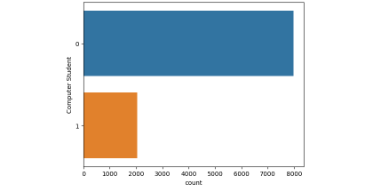
Class Imbalance
Class imbalance is a common issue in predictive modeling where the classes are not represented equally in the training data. In the context of predicting student records, this could mean that the number of students who pass is much larger than the number of students who fail .
Techniques is :
Imblearn

Slide 6
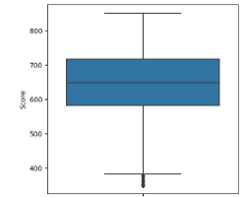
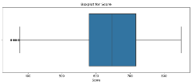
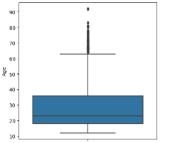
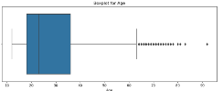
Outlier Treatment
Outlier identification:
outlier were detected in the “Score” and “Age” columns.
Column Classifications:
“Score” and “Age” columns are numerical columns are requiring outlier treatment.
Outlier Treatment Technique:
Standard deviation method used outlier in this column

Slide 7
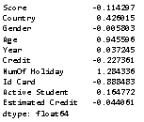
Skewness Treatment
Skewness treating techniques:
square root
cube root

Slide 8
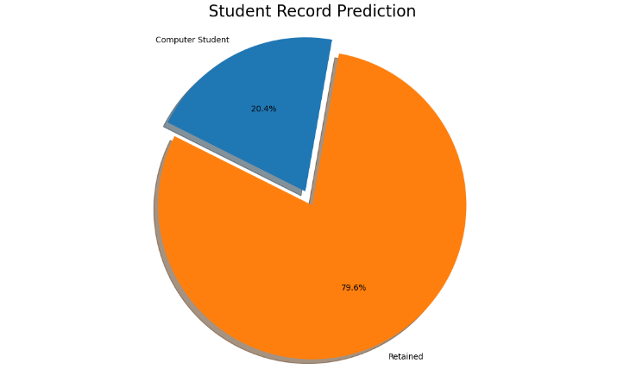
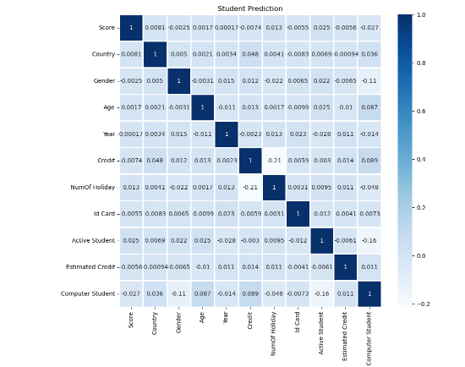
Card title
Donut Chart
Correlation Heat map

Slide 9
Model data frame-2
After applying class imbalance,outlier treatment and skewness data frame is:
in this case Random forest model is good fitted to the data
Rrrrrrrrrrrrrrrrrrrrrrrrrrrrrrrrrrrrrrrrrrrrrrrrrrrrrrrrrrrrrrrrrrrrrrrrrr
Algorithm | Accuracy | Precision | Recall | f1-score
0 | Logistic Regression | 53.966761 | 0.533482 | 0.602015 | 0.537898
1 | Decision Tree | 90.341800 | 0.855556 | 0.969773 | 0.903016
2 | Random Forest | 94.888680 | 0.925373 | 0.976071 | 0.948854
3 | KNN | 70.147382 | 0.658524 | 0.831864 | 0.696423
4 | XGB | 87.927250 | 0.855286 | 0.911839 | 0.879158
5 | SVM | 54.907495 | 0.535511 | 0.712217 | 0.536889
6 | Naive Bayes | 53.276889 | 0.531572 | 0.519521 | 0.532688

Slide 10
Feature selection
Selecting the importance feature:
Technique applied:recursive feature elimination
Selecting five important features based on that created data frame and fitted all frame.

Slide 11
THANK YOU

